Slide 1

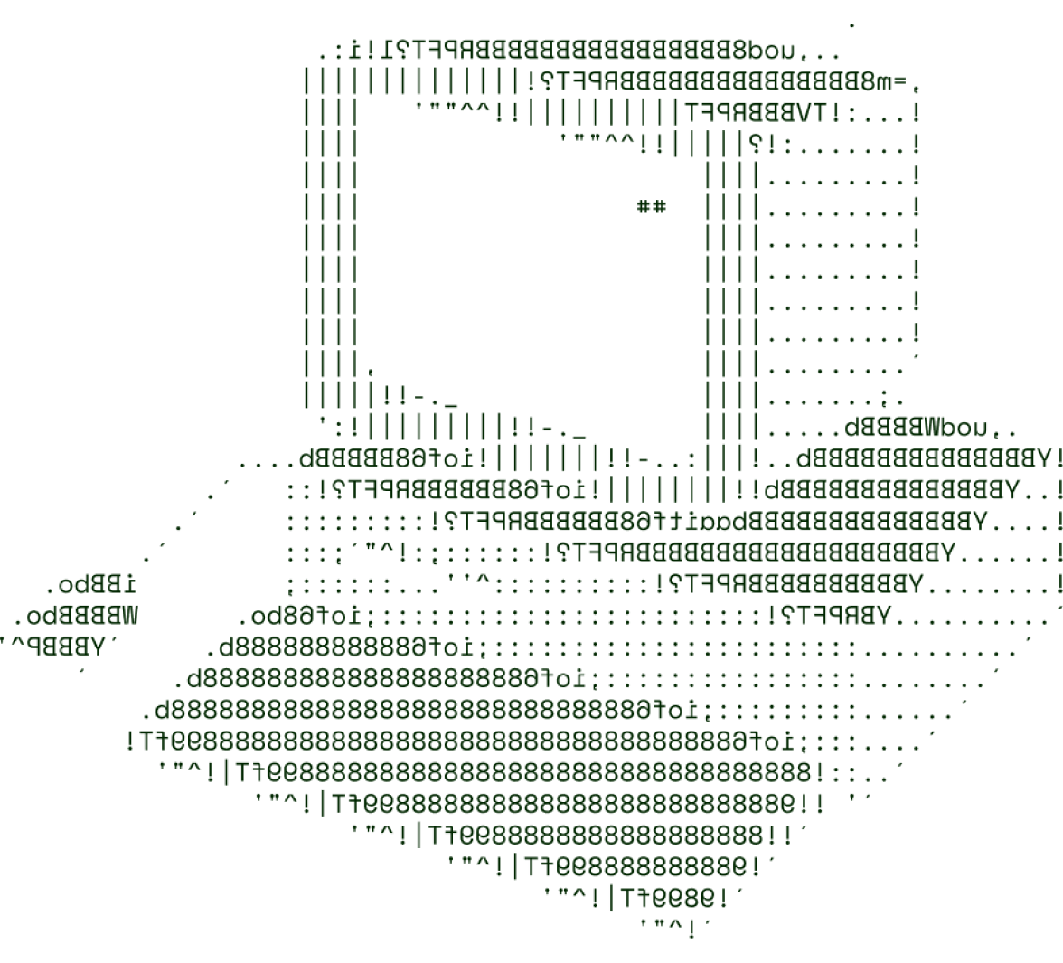

Activity-Based Prediction of Digital Overuse in Youth
AI-Enthusiasts

Slide 2

SOLUTION OVERVIEW
Solution Overview A predictive model using physical fitness data (activity, posture, diet) to detect early signs of problematic internet use in children
How it addresses the problem
Simplifies detection by using accessible physical indicators, bypassing complex, professional evaluations.
Innovation and uniqueness of the solution
Leverages physical health data to predict internet overuse, offering real-time monitoring without specialized tools.
Highlight its key features and benefits
Accessible: Common fitness indicators, no expert tools needed.
Easy to use: Families and schools can easily monitor.
Early Detection: Detects early signs for timely intervention.
Health Focused: Promotes balance between digital use and wellness.

Slide 3
TECHNICAL ARCHITECTURE
Frontend Technologies: Streamlit.
Backend Technologies: Flask
Other Tools/Services:
Machine learning libraries: Pandas, NumPy, Matplotlib, Scikit-learn etc.,
Machine learning algorithms: Random Forest, PCA etc.,

Slide 4
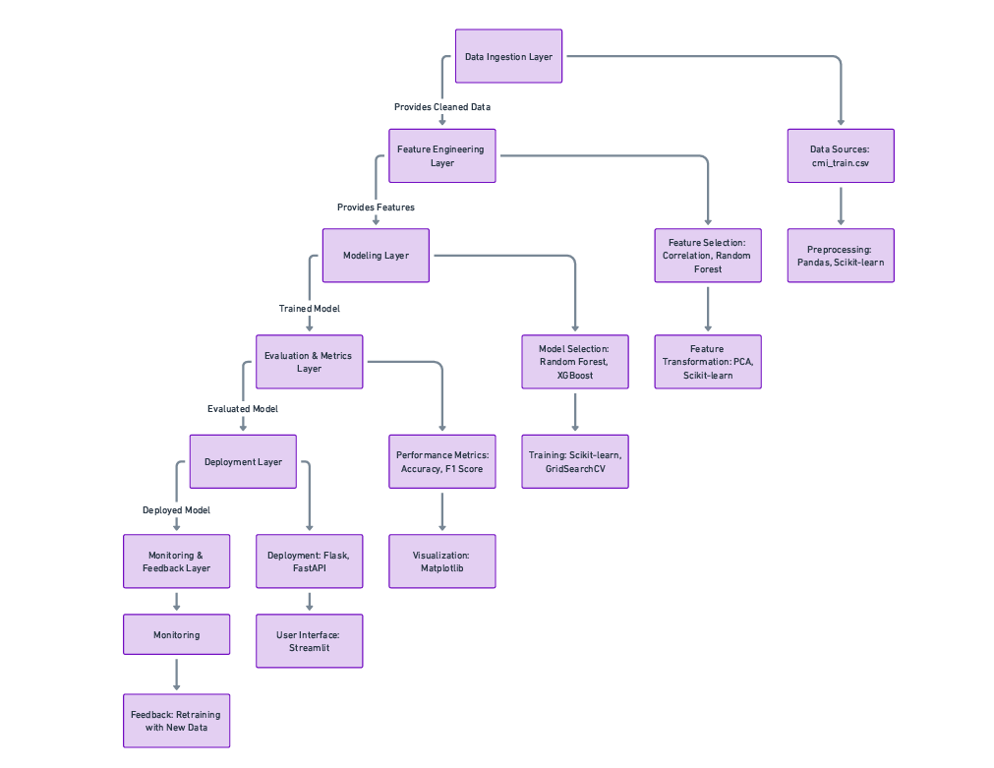
TECHNICAL ARCHITECTURE
Flow chart

Slide 5
SCALABILITY AND FUTURE SCOPE
Scalability and Architecture
Our solution will use cloud platforms (AWS, Google Cloud) for dynamic scaling and load balancing. Microservices and containerization (Docker, Kubernetes) allow each component to scale independently, ensuring flexibility and global availability.
Technologies and Future Features
We plan to use serverless computing for on-demand tasks, a user-friendly dashboard, real-time alerts, and integration with wearables. Multi-language support will expand accessibility.
This scalable, innovative solution leverages physical data to promote digital wellness and early intervention across diverse communities.

Slide 6
FEASIBILITY
Potential challenges and risks
Accuracy and Validity of Physical Indicators: Relying on physical fitness indicators as proxies may not capture all aspects of problematic internet use, and some physical changes may have unrelated causes.
Data Privacy and Security: Collecting and analyzing sensitive data about children’s health and behaviors raises concerns about privacy and data protection.
Strategies for overcoming these challenges:
Regularly refine the model by incorporating feedback from clinical professionals, additional datasets, and cross-validation methods to improve reliability.
Implement strict data protection policies, including data anonymization, secure storage, and access controls. Compliance with data privacy regulations will be prioritized to safeguard children’s information.

Slide 7

AI ENTHUSIASTS

Slide 8




Trishank Samineni
Charwick Hamesh
Team lead
AI Enthusiasts
Co-lead
AI Enthusiasts
N Sudarshan Reddy
Dhanush L
Team member
AI Enthusiasts
Team member
AI Enthusiasts

Slide 9

Thanks for Joining

